Slide 1
Lower Bounds
Lower bound: an estimate on a minimum amount of work needed to solve a given problem
Examples:
number of comparisons needed to find the largest element in a set of n numbers
number of comparisons needed to sort an array of size n
number of comparisons necessary for searching in a sorted array
number of multiplications needed to multiply two n-by-n matrices

Slide 2
Lower Bounds (cont.)
Lower bound can be
  an exact count
  an efficiency class (Ω)
Tight lower bound: there exists an algorithm with the same efficiency as the lower bound
Problem Lower bound Tightness
sorting Ω(nlog n) yes
searching in a sorted array Ω(log n) yes
element uniqueness Ω(nlog n) yes
n-digit integer multiplication Ω(n) unknown
multiplication of n-by-n matrices Ω(n²) unknown

Slide 3
Methods for Establishing Lower Bounds
trivial lower bounds
information-theoretic arguments (decision trees)
adversary arguments
problem reduction

Slide 4
Trivial Lower Bounds
Trivial lower bounds: based on counting the number of items that must be processed in input and generated as output
Examples
finding max element
polynomial evaluation
sorting
element uniqueness
Hamiltonian circuit existence
Conclusions
may and may not be useful
be careful in deciding how many elements must be processed

Slide 5
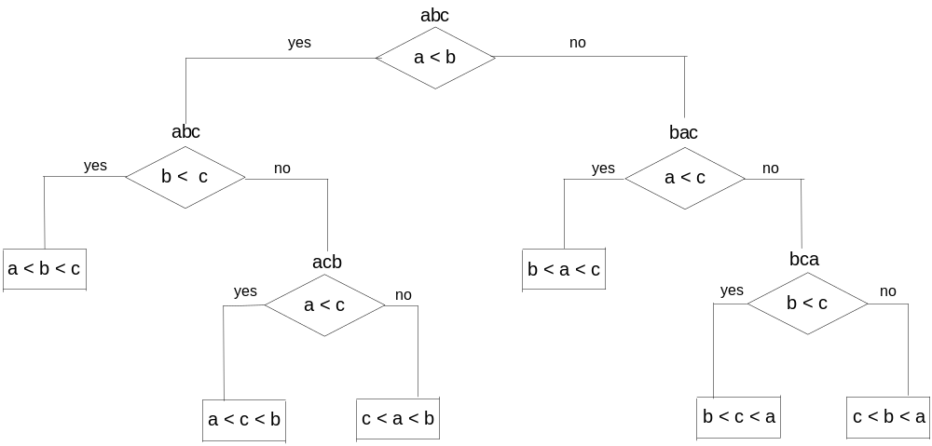
Decision Trees
Decision tree — a convenient model of algorithms involving
comparisons in which:
internal nodes represent comparisons
leaves represent outcomes
Decision tree for 3-element insertion sort

Slide 6
Decision Trees and Sorting Algorithms
Any comparison-based sorting algorithm can be represented by a decision tree
Number of leaves (outcomes) ≥ n!
Height of binary tree with n! leaves ≥ ⎡log₂n!⎤
Minimum number of comparisons in the worst case ≥ ⎡log₂n!⎤ for any comparison-based sorting algorithm
⎡log₂n!⎤ ≈ n log₂n
This lower bound is tight (mergesort)

Slide 7
Adversary Arguments
Adversary argument: a method of proving a lower bound by
playing role of adversary that makes algorithm work the hardest
by adjusting input
Example 1: “Guessing” a number between 1 and n with yes/no
questions
Adversary: Puts the number in a larger of the two subsets
generated by last question
Example 2: Merging two sorted lists of size n
a₁ < a₂ < … < a_{n} and b₁ < b₂ < … < b_{n}
Adversary: a_{i} < b_{j} iff i < j
Output b₁ < a₁ < b₂ < a₂ < … < b_{n} < a_{n} requires 2n-1 comparisons
of adjacent elements

Slide 8
Lower Bounds by Problem Reduction
Idea: If problem P is at least as hard as problem Q, then a lower
bound for Q is also a lower bound for P.
Hence, find problem Q with a known lower bound that can
be reduced to problem P in question.
Example: P is finding MST for n points in Cartesian plane
Q is element uniqueness problem (known to be in Ω(nlogn))

Slide 9
Classifying Problem Complexity
Is the problem tractable, i.e., is there a polynomial-time (O(p(n)) algorithm that solves it?
Possible answers:
yes (give examples)
no
  because it’s been proved that no algorithm exists at all
  (e.g., Turing’s halting problem)
  because it’s been be proved that any algorithm takes exponential time
unknown

Slide 10
Problem Types: Optimization and Decision
Optimization problem: find a solution that maximizes or minimizes some objective function
Decision problem: answer yes/no to a question
Many problems have decision and optimization versions.
E.g.: traveling salesman problem
optimization: find Hamiltonian cycle of minimum length
decision: find Hamiltonian cycle of length ≤ m
Decision problems are more convenient for formal investigation of their complexity.

Slide 11
Class P
P: the class of decision problems that are solvable in O(p(n)) time, where p(n) is a polynomial of problem’s input size n
Examples:
searching
element uniqueness
graph connectivity
graph acyclicity
primality testing (finally proved in 2002)

Slide 12
Class NP
NP (nondeterministic polynomial): class of decision problems whose proposed solutions can be verified in polynomial time = solvable by a nondeterministic polynomial algorithm
A nondeterministic polynomial algorithm is an abstract two-stage procedure that:
generates a random string purported to solve the problem
checks whether this solution is correct in polynomial time
By definition, it solves the problem if it’s capable of generating and verifying a solution on one of its tries
Why this definition?
led to development of the rich theory called “computational complexity”

Slide 13
Example: CNF satisfiability
Problem: Is a boolean expression in its conjunctive normal form (CNF) satisfiable, i.e., are there values of its variables that makes it true?
This problem is in NP. Nondeterministic algorithm:
Guess truth assignment
Substitute the values into the CNF formula to see if it evaluates to true
Example: (A | ¬B | ¬C) & (A | B) & (¬B | ¬D | E) & (¬D | ¬E)
Truth assignments:
A B C D E
0 0 0 0 0
. . .
1 1 1 1 1
Checking phase: O(n)

Slide 14
What problems are in NP?
Hamiltonian circuit existence
Partition problem: Is it possible to partition a set of n integers into two disjoint subsets with the same sum?
Decision versions of TSP, knapsack problem, graph coloring, and many other combinatorial optimization problems. (Few exceptions include: MST, shortest paths)
All the problems in P can also be solved in this manner (no guessing is necessary), so we have:
    P ⊆ NP
Big question: P = NP ?

Slide 15
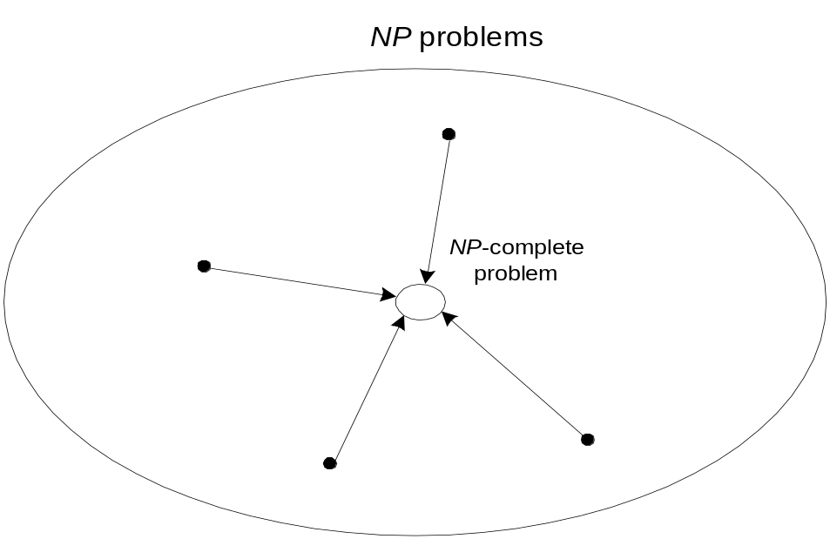
NP-Complete Problems
A decision problem D is NP-complete if it’s as hard as any
problem in NP, i.e.,
D is in NP
every problem in NP is polynomial-time reducible to D
Cook’s theorem (1971): CNF-sat is NP-complete

Slide 16
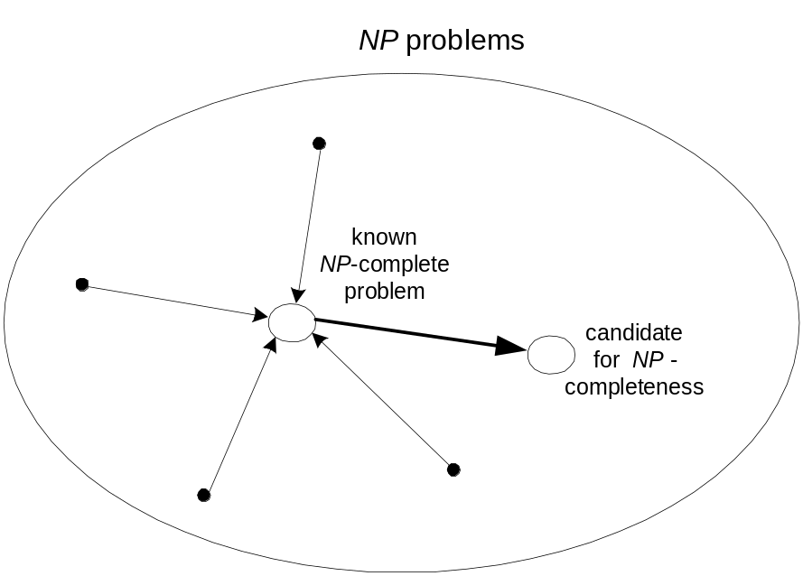
NP-Complete Problems (cont.)
Other NP-complete problems obtained through polynomial-
time reductions from a known NP-complete problem
Examples: TSP, knapsack, partition, graph-coloring and
hundreds of other problems of combinatorial nature

Slide 17
P = NP ? Dilemma Revisited
P = NP would imply that every problem in NP, including all NP-complete problems, could be solved in polynomial time
If a polynomial-time algorithm for just one NP-complete problem is discovered, then every problem in NP can be solved in polynomial time, i.e., P = NP
Most but not all researchers believe that P ≠ NP , i.e. P is a proper subset of NP

